Slide 1
SENG 438 Software Testing, Reliability & Quality
Chapter 2: Foundations of Testing
Department of Electrical & Computer Engineering, University of Calgary
B.H. Far （far@ucalgary.ca）
http://people.ucalgary.ca/~far

Slide 2
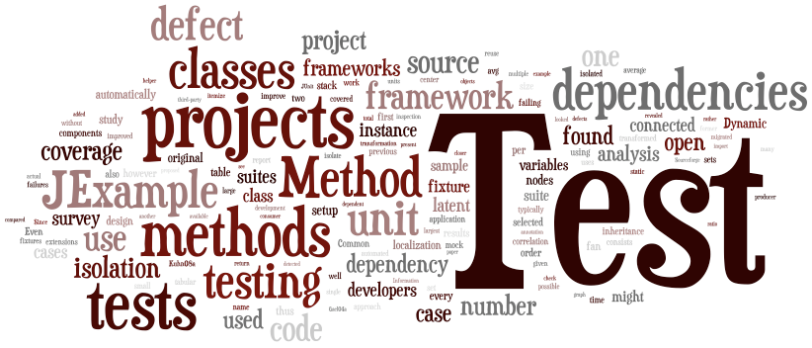
Contents
Introduction to testing
What is software testing?
Manual (human-based) software testing
Ad-hoc, exploratory, scripted testing
Bug report
Manual regression testing
Assignment 1
Software testing life-cycle

Slide 3
What Do We Know So Far?
Software errors/faults are inevitable
Software failure are expensive and sometimes life threatening
Testing is a practical approach for finding faults to avoid failure
The need for software testers and test engineers is growing fast
We learn the basics of testing in this class

Slide 4
Validation & Verification
Requirements
Building the thing right
Building the right thing
Notes:
In the first eight weeks of the course we focus on the right side of this figure and in the last four weeks we turn our attention to the left side.

Slide 5
Testing
Software Testing: Techniques to execute programs with the intent of finding as many defects as possible and/or gaining sufficient confidence in the software system under test.
“Program testing can show the presence of bugs, never their absence” (Dijkstra, 1972)

Slide 6
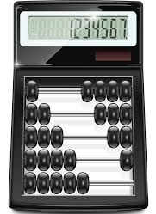
Brainstorming
How would you test a Calculator app?
Contextual knowledge
Test plan
How many inputs (test cases)?
So MANY possibilities
Tedious!
How to know the outputs are correct?!

Slide 7
Brainstorming
How to know the outputs are correct?!
Cube root of 7 in Calculator
This the expected value:
But a manual tester runs and gets:
We need to set the correct expected output!

Slide 8
Test Case & Test Suite
A test case is set of inputs and the expected outputs (oracle) for a unit/module/system under test
A test suite (test set) is set of test cases
Without the expected outputs, a test case is NOT complete
e.g., for Calculator:

Slide 9
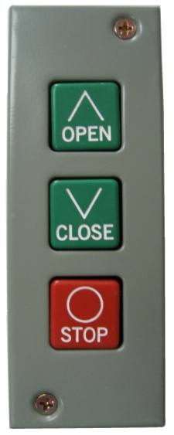

Test Case & Test Suite
Direct input variable: a variables that controls the operation directly
Example: arguments, selection menu, entered data field
Important during exploratory/unit test
Indirect input variable: a variable that only influences the operations or its effects are propagated to the operation
Example: traffic load, environmental variable
Important during integration testing

Slide 10
Test Case
A “test case” for a given functionality is specifying its direct input variables and the expected outcome
Specification of the indirect input variable gives a test case the necessary context
During initial test stages (e.g. unit testing and regression test), the influence of indirect input variables should be kept to minimum to ensure that the function being tested is reliable
Indirect input variables are effective during integration and system test

Slide 11
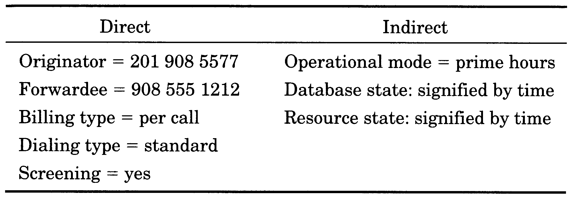
Example
Example of direct and indirect input variables for a functionality to be tested
Telephone dialing system
Example from Musa’s Book

Slide 12
Example
Test case is specified with its direct input variables and expected outcome
In theory, it is possible (but may not be practical) to record all the input variables needed to initiate the runs that make up the whole execution space of the software
Expected outcome: pass
Example from Musa’s Book

Slide 13
Brain Storming
How will you test the Notepad or Word?
Planning:
– similarities – differences
• Oracles
• Level of testing
• Test case and test suite

Slide 14
Test Case & Test Suite
The definitions hold for test cases in any level, unit, integration or system testing
Example, for Microsoft Word:

Slide 15
Test Case Design
The art and science of deriving efficient but effective number of test cases is called “test case design”
“Less is more!”
Less test cases, but maximizing the chance of covering faults

Slide 16
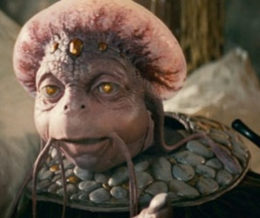
Testing Process Overview

Slide 17
Types of Test Activities
Test-case Design: Exploratory (human-based)
Design test values based on domain knowledge of the program and human knowledge of testing, exploratory testing
Test-case Design: Criteria-based
Design test values to satisfy coverage criteria or other engineering goal
Test Automation
Embed test values into executable scripts
Test Execution
Run tests on the software and record the results
Test Evaluation
Evaluate results of testing, report to developers

Slide 18
Types of Test Activities
Background Knowledge Needed
Notes:
Math knowledge is mainly probability and statistics.

Slide 19
Test Case Design
Human-based
Ad-hoc
Exploratory
Scripted
Criteria-based (later)

Slide 20
Testing Approaches
Exploratory testing
In exploratory testing, tests are designed and executed at the same time
Unscripted doesn’t mean unprepared
It’s about enabling choice not constraining it
Scripted testing
In scripted testing, tests are first designed and recorded Then they may be executed at some later time or by same or a different tester
With a script, you miss the same things every time!

Slide 21
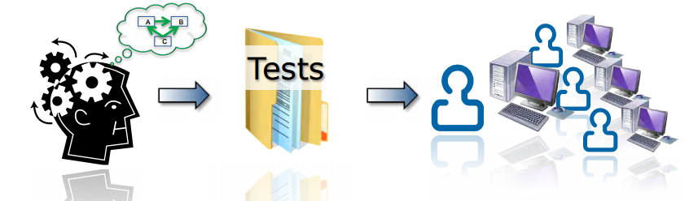
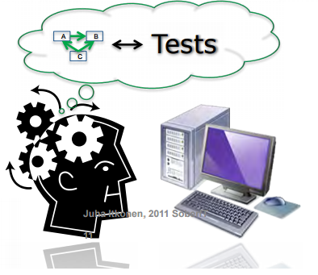
Scripted vs. Exploratory
Scripted Testing
Most testing techniques (i.e. boundary value analysis, decision tables, etc.) can be used in both scripted and exploratory ways
Exploratory Testing

Slide 22

Exploratory Approach
Human tester
Using brain, and fingers
To create “realistic” scenarios that
will cause software either to fail or to fulfill its mission
No strict plan (formal instructions)
In Exploratory Testing tester should increases their knowledge by exploring the application/software. Testers design and execute the next test based on the result of current step.
Notes:
Exploratory testing is a refined form of Ad-hoc testing.
In Ad-hoc testing tests might be executed randomly.
In Exploratory Testing tester should increases their knowledge by exploring the application/software. Testers design and execute the next test based on the result of current step.

Slide 23
Exploratory Approach
Human-based testing is all about varying things
Input:
• Input combinations
• Order of inputs
• Legal versus illegal inputs
• Normal versus special
• Default / user supplied
State:
• History of stimuli paths
• Routes through environment
• Simulate the real world use of the SUT

Slide 24
Test Case Design
Equivalent classes
Boundary conditions
Visible state transition
More about these comes later

Slide 25
Exploratory testing level
In the small
In the large

Slide 26
Exploratory Testing in the Small
Testing a small feature by choosing
which inputs to apply
what pages or screens to visit
which menu items to select
and the exact values to type into each input field they see.
There are literally hundreds of such decisions to make with every test case we run
Exploratory testing can help a tester make these decisions, by varying things inputs, states, environment, user data, etc.

Slide 27
Exploratory Testing in the Small
Example: in MS Word…
Legal versus illegal input
User Input
State
A state of software is a coordinate in the state space that contains exactly one value for every internal data structure.
User Data
Database contents, files, etc.
Environment
E.g., OS and its configurations

Slide 28
Exploratory Testing in the Small
Example: in MS Word…
Each unit/feature is considered in isolation

Slide 29
Exploratory Testing in the Large
Testing units/features together
Concerning feature interaction, data flows, and choosing paths
Have an strategy in advance and let the goal guide you during testing sessions
Exploratory testing in the Large: sequence of several small test cases
e.g.,
open file → change text → change font → save → close →
open it again → check if the changes were correctly saved
Sequence of several small functionalities: operation

Slide 30
Hybrid Exploratory Testing
Scenarios and exploration
Use scenarios like maps
Scenarios
User story, requirement, feature, an integration, setup, things that go wrong, etc.
Create variation in scenarios
Add steps: different paths
Modify steps: Change data, environment, etc.
Remove and repeat steps

Slide 31
Crowd Testing
A natural match for exploratory testing
How It Works?
Tell us your testing requirements
Optionally create or import test cases
We’ll select testers who best match your requirements
You’ll receive a list of bugs and feedback from real world testing
You can ask testers for additional details & information
You can also export your bugs to popular bug tracking systems

Slide 32
Manual Scripted Testing
Scripted testing follows a path that is written by the tester themselves (or someone else)
The script includes test cases and test steps that are documented
No deviation from the path laid out in the script
Notes:
Scripted testing follows a path that is written by the tester themselves or someone else. The script includes test cases and test steps that are documented. There can be no deviation from the path laid out in the script. The tester’s job in a scripted environment is to color within the lines only, follow each instruction to the nth degree and report on the findings.
Exploratory tests, on the other hand, rely on the tester to develop the testing path ‘on the go’. It’s not exactly a testing ‘free-for-all’ but it allows the tester to go where an end user might go rather than where a script tells them to go.

Slide 33
Manual Regression Testing
Regression testing is testing done to check that a system update does not reintroduce faults that have been corrected earlier
Usually performed after bug fix code is checked in to the repository

Slide 34
Human-based Testing Limitation
Scalability, and bias
Does exploratory testing scale up to very complex systems?
Can a human tester keep track of what he has tested and what not?
Can we do a complete testing job on MS Word only by exploratory approach?!
← focus on a subset of features
Usually no!
Usually no!
Perhaps no!

Slide 35
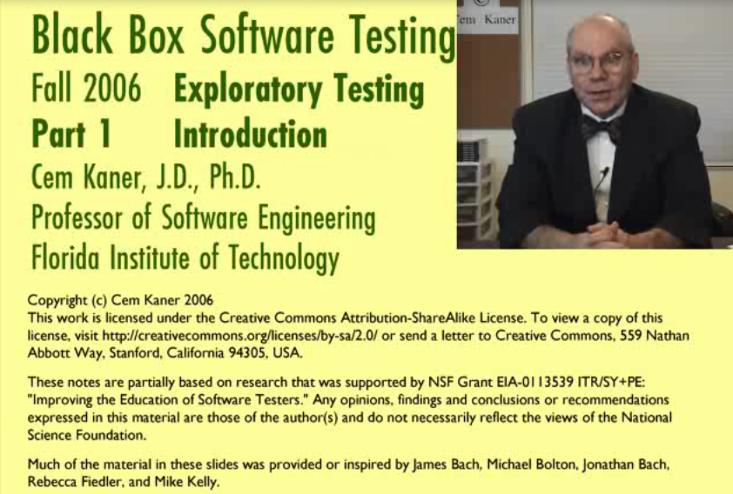
Video
Lecture Video (16 mins)
How to Become a Software Tester? (5 min)
Software testing tutorial (one hour)
etc.

Slide 36
SENG 438 Software Testing, Reliability & Quality
Software Testing Life Cycle (STLC)

Slide 37
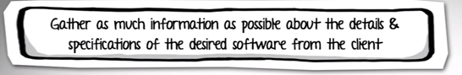
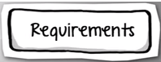
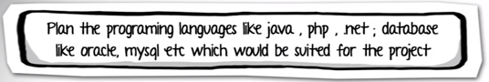



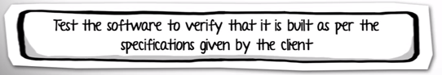

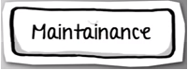
Software Development Life Cycle (SDLC)
Time
Document discussing various SDLC in D2L!

Slide 38
Testing throughout the SDLC – in Waterfall
SDLC: Software Development Life Cycle
Life-cycle development artifacts provides a rich source of test data
Identifying test requirements and test cases early helps shorten the development time
They may help reveal faults
It may also help identify early low testable specifications or design
Analysis
Design
Implementation
Testing
Preparation
for Test
Preparation
for Test
Unit
Testing
Acceptance,
system Testing
Notes:
https://www.youtube.com/watch?v=An7HC1LolDM&list=PLDC2A0C8D2EC934C7&index=3

Slide 39
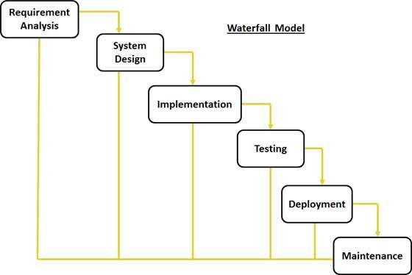
Testing in Waterfall

Slide 40
Waterfall Model Pros & Cons
Pros | Cons
Simple and easy to understand and use Easy to manage due to the rigidity of the model because ach phase has specific deliverables and a review process Phases are processed and completed one at a time Works well for smaller projects where requirements are very well understood Clearly defined stages Easy to arrange tasks Process and results are well documented | No working software is produced until late during the life cycle High amounts of risk and uncertainty Not a good model for complex and object-oriented projects Poor model for long and ongoing projects It does not allow for much reflection or revision, i.e. once an application is in the testing stage, it is very difficult to go back and change something that was not well-documented

Slide 41
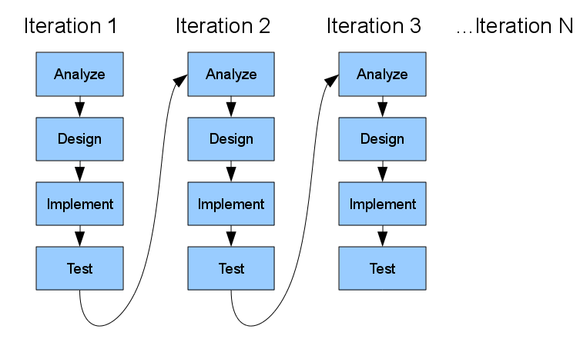
Testing in Iterative Model
Iterative process starts with a simple implementation of a subset of the software requirements
At each iteration, design modifications are made and new functional capabilities are added
The basic idea behind this method is to develop a system through repeated cycles (iterative) and in smaller portions at a time (incremental)

Slide 42
Iterative Model Pros & Cons
Pros | Cons
Some working functionality can be developed quickly and early in the life cycle Results are obtained early and periodically Parallel development can be planned Less costly to change the scope/requirements Testing and debugging during smaller iteration is easy Risks are identified and resolved during iteration and each iteration is an easily managed milestone Easier to manage risk - High risk part is done first With every increment operational product is delivered Issues, challenges and risks identified from each increment can be utilized/applied to the next increment During life cycle software is produced early which facilitates customer evaluation and feedback | More resources may be required More management attention is required System architecture or design issues may arise because not all requirements are gathered in the beginning of the entire life cycle Management complexity is more End of project may not be known which is a risk Highly skilled resources are required for risk analysis

Slide 43
Testing in the “V” Model
Write test
Run test

Slide 44
V-Model Testing Stages
Unit testing
Testing of individual components.
Integration testing
Testing to expose problems arising from the combination of components.
System testing
Testing the complete system prior to delivery
Acceptance testing
Testing by users to check that the system satisfies requirements. Sometimes called alpha testing
https://www.youtube.com/watch?v=N8-qNMHOVyw&index=5&list=PLDC2A0C8D2EC934C7
Notes:
https://www.youtube.com/watch?v=N8-qNMHOVyw&index=5&list=PLDC2A0C8D2EC934C7

Slide 45
V- Model Pros and Cons
Pros | Cons
This is a highly disciplined model and Phases are completed one at a time Works well for smaller projects where requirements are very well understood Simple and easy to understand and use Easy to manage due to the rigidity of the model, that is, each phase has specific deliverables and a review process | High risk and uncertainty Not a good model for complex and object-oriented projects Poor model for long and ongoing projects Not suitable for the projects where requirements are at a moderate to high risk of changing Once an application is in the testing stage, it is difficult to go back and change a functionality No working software is produced until late during the life cycle

Slide 46
Testing in Agile Model
Agile methods are being widely accepted in the software world recently
In agile the tasks are divided to time boxes (small time frames) to deliver specific features for a release
Working software build is delivered after each iteration

Slide 47
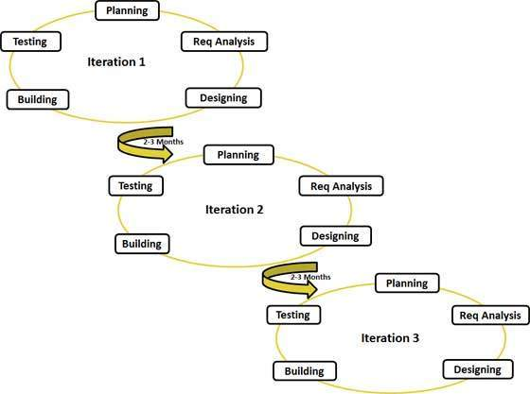
Testing in the Agile

Slide 48
Agile Model Pros & Cons
Pros | Cons
Is a realistic approach to software development Functionality can be developed rapidly and demonstrated Resource requirements are minimum Suitable for fixed or changing requirements Delivers early partial working solutions Good model for environments that change steadily Minimal rules, documentation easily employed Little or no planning required Gives flexibility to developers | An overall plan, an agile leader and agile project manager practice is a must without which it will not work Strict delivery management dictates the scope, functionality to be delivered, and adjustments to meet the deadlines There is very high individual dependency since there is minimum documentation generated Transfer of technology to new team members may be quite challenging due to lack of documentation

Slide 49
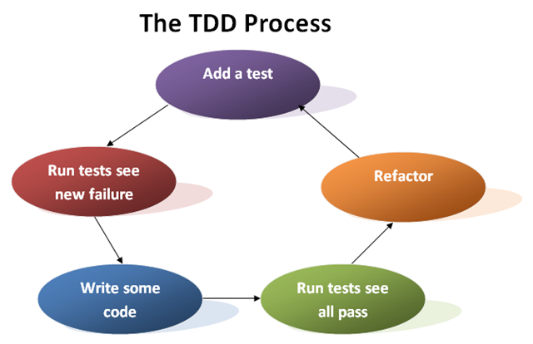
Testing in TDD
(TDD = Test-Driven Development )
Step 1
Get Requirements
In TDD, test cases are actually the requirements of the system
Document introducing TDD in D2L!

Slide 50
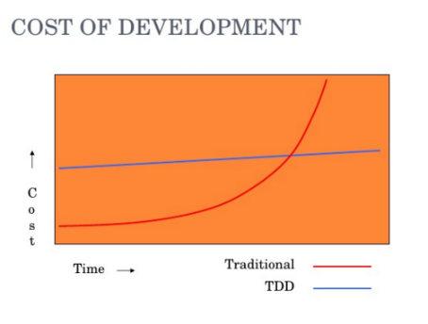
TDD Model Pros & Cons
Pros | Cons
TDD shortens the programming feedback loop Guarantees the development of high quality software Provides concrete evidence that software is working Less debug time Reduced software failure rate | Programmers like to code, not to test Test writing is time consuming

Slide 51
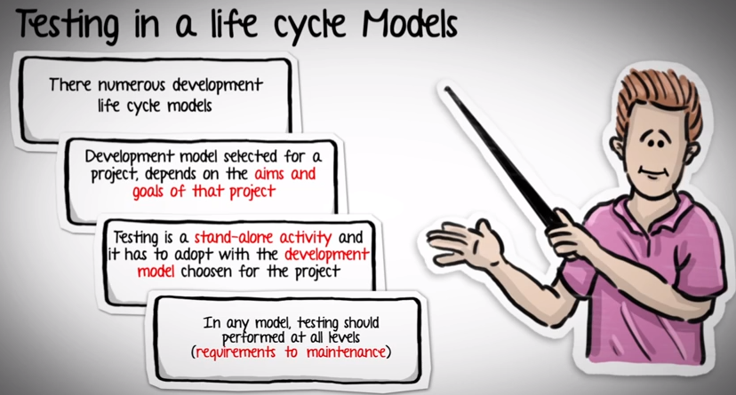
SDLC - Conclusion

Slide 52
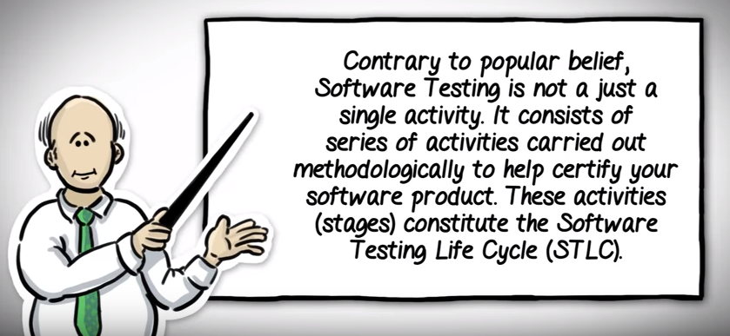
Software Testing Life Cycle (STLC)
Notes:
https://www.youtube.com/watch?v=Dq5IYYqnnGQ&index=24&list=PLDC2A0C8D2EC934C7

Slide 53
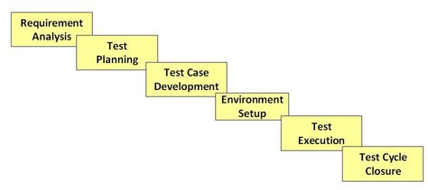
Software Testing Life Cycle (STLC)
https://www.youtube.com/watch?v=Dq5IYYqnnGQ&index=24&list=PLDC2A0C8D2EC934C7
Notes:
https://www.youtube.com/watch?v=Dq5IYYqnnGQ&index=24&list=PLDC2A0C8D2EC934C7

Slide 54
Requirement Analysis
Test team studies the requirements from a testing point of view to identify the testable requirements.
The QA team may interact with various stakeholders (Client, Business Analyst, Technical Leads, System Architects etc.) to understand the requirements in detail.
Requirements could be either Functional (defining what the software must do) or Non Functional (defining system performance /security availability).
Automation feasibility for the given testing project is also done in this stage.

Slide 55
Requirement Analysis
Activities
Identify types of tests to be performed.
Gather details about testing priorities and focus.
Prepare Requirement Traceability Matrix (RTM).
Identify test environment details where testing is supposed to be carried out.
Automation feasibility analysis (if required).
Deliverables
RTM
Automation feasibility report (if applicable).

Slide 56
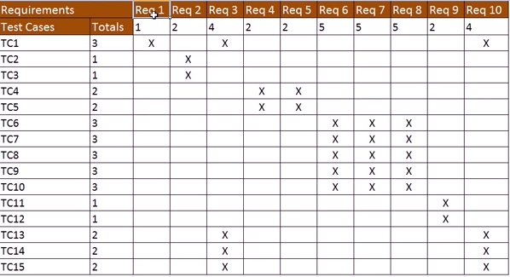
Requirement Traceability Matrix (RTM)
Notes:
Actually RTM is composed of two tables: one mapping business req to technical req and the second one mapping tech req to test cases.

Slide 57
Requirement Traceability Matrix (RTM)
Discussion
How RTM can help test engineers?
How RTM can help project managers?
Notes:
Are all requirements tested?
Are we on schedule with development and testing?

Slide 58
Test Planning
This phase is also called Test Strategy phase
Typically, a Senior QA manager will determine effort and cost estimates for the project and would prepare and finalize the Test Plan

Slide 59
Test Planning
Activities
Preparation of test plan/strategy document for various types of testing
Test tool selection
Test effort estimation
Resource planning and determining roles and responsibilities.
Training requirement
Deliverables
Test plan /strategy document.
Effort estimation document.
There are templates for documents such as test plan, etc. For example: IEEE 829 Test Plan

Slide 60
What to write in a Test Plan Document
Introduction: Overview, goals/objectives, Any constraints.
References: List the related documents, Project Plan, Configuration Management Plan
Test Items: List the test items (software/products) and their versions.
Features to be Tested
Features Not to Be Tested
Approach: [Manual/Automated; White Box/Black Box/Gray Box]
Pass/Fail Criteria
Suspension Criteria and Resumption Requirements

Slide 61
What to write in a Test Plan Document
Test Deliverables: Test Cases, Test Scripts, Defect/Enhancement Logs, Test Reports.
Test Environment: hardware, software, network.
Estimate: test estimates (cost or effort) and/or provide a link to the detailed estimation.
Schedule
Staffing and Training Needs
Responsibilities
Risks
Assumptions and Dependencies
Approvals
Sample test plan in D2L!

Slide 62
Software Testing Life Cycle (STLC)

Slide 63
Test Case Development
This phase involves creation, verification and rework of test cases and test scripts. Test data, is identified/created and is reviewed and then reworked.
Activities
Create test cases, automation scripts (if applicable)
Review and baseline test cases and scripts
Create test data (If Test Environment is available)
Deliverables
Test cases/scripts
Test data
Sample test case worksheet in D2L!

Slide 64
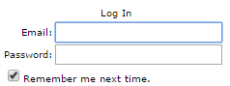
What to Write in a Test Case?
Test case design date: Test Designed By: |  |  |  | Test case Executed date: Test Executed by:
Pre-Conditions
TC # | Scenario | Test case | Test Data | Test Steps | Expected Results | Actual Result | Pass/ Fail
1 | Check Login Functionality | Check response on entering valid login information | Username: SENG Password: 437 | Launch application Enter username Enter password Clock ok button | Login must be successful
Post-Condition

Slide 65
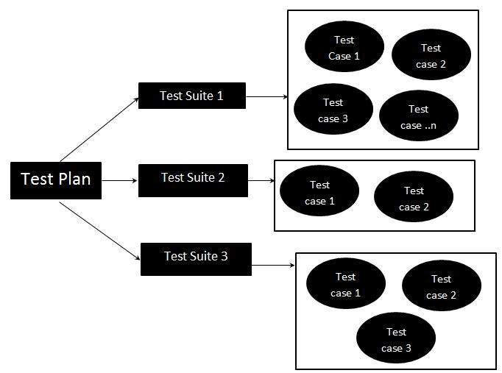
What is a Test Suite?
Test Suite is not equal to Test Case
Test suite is a set of test cases that needs to be run on a software
test fixture
unit test
test case
test suite
test runner
Notes:
A test fixture sets up the data (both objects and primitives) that are needed to run tests
– Example: If you are testing code that updates an employee record, you need an employee record to test it on
A unit test is a test of a single class
A test case tests the response of a single method to a particular set of inputs
A test suite is a collection of test cases
A test runner is software that runs tests and reports
results

Slide 66
Software Testing Life Cycle (STLC)

Slide 67
Test Environment Setup
Test environment decides the software and hardware conditions under which a work product is tested
Test environment set-up is one of the critical aspects of testing process and can be done in parallel with Test Case Development Stage
Test team may not be involved in this activity if the customer/development team provides the test environment in which case the test team is required to do a readiness check (smoke testing) of the given environment

Slide 68
Test Environment Setup
Activities
Understand the required architecture, environment set-up and prepare hardware and software requirement list for the Test Environment
Setup test environment and test data
Perform smoke test on the build
Deliverables
Environment ready with test data set up

Slide 69
Software Testing Life Cycle (STLC)

Slide 70
Test Execution
During this phase test team will carry out the testing based on the test plans and the test cases prepared
Bugs will be reported back to the development team for correction and retesting will be performed

Slide 71
Test Execution
Activities
Execute tests as per plan
Document test results, and log defects for failed cases
Map defects to test cases in RTM
Retest the defect fixes
Track the defects to closure
Deliverables
Completed RTM with execution status
Test cases updated with results
Defect reports
We will discuss this soon!

Slide 72
Reporting: Execution Results

Slide 73
Reporting: TBF

Slide 74
Software Testing Life Cycle (STLC)

Slide 75
Test Cycle Closure
Testing team will meet, discuss and analyze testing artifacts to identify strategies that have to be implemented in future, taking lessons from the current test cycle
The idea is to remove the process bottlenecks for future test cycles and share best practices for any similar projects in future

Slide 76
Test Cycle Closure
Activities
Evaluate cycle completion criteria based on Time, Test coverage, Cost, Software, Critical Business Objectives, Quality
Prepare test metrics
Document the learning out of the project
Prepare Test closure report
Qualitative and quantitative reporting of quality of the work product to the customer
Test result analysis to find out the defect distribution by type and severity
Deliverables
Test Closure report
Test metrics

Slide 77
Test Completion Criteria
Completion or exit criteria apply to all levels of testing to determine when to stop
Coverage, using a measurement technique,
e.g. branch coverage for unit testing
User requirements
Most frequently used transactions
Failures found (e.g. versus expected)
Cost or time
We will discuss this again later!

Slide 78
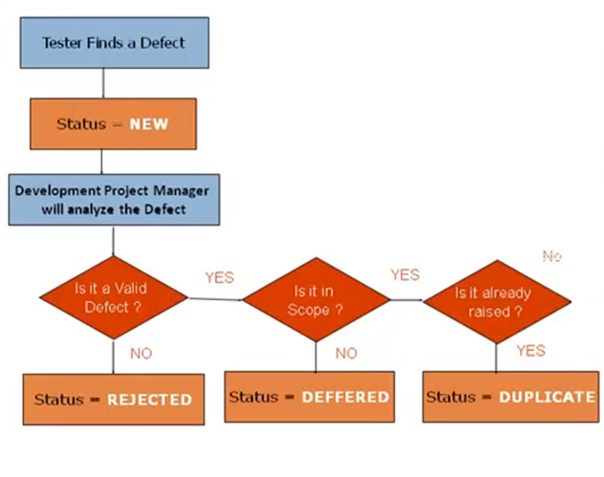
Failure Life Cycle

Slide 79
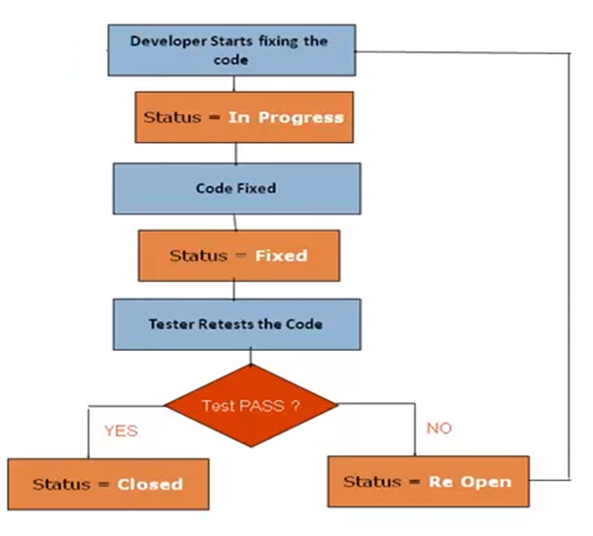
Bug Life Cycle

Slide 80
Let’s Write Some Test Cases
Triangle program
IVMS project (automotive data acquisition and monitoring)
Notes:
IVMS = In Vehicle Monitoring System
IVMS that collects info from the car and drivers’ cell phone; sends it to a repository; has Web and App interface

Slide 81
Exercise: Triangle Program
Triangle program
Requirements:
The triangle program accepts three integers, a, b, and c, as input. These are taken to be sides of a triangle. The integers a, b, and c must satisfy the following conditions:
C1) 1<= a <= 200
C2) 1<= b <= 200
C3) 1<= c <= 200
C4) a < b + c
C5) b < a + c
C6) c < a + b

Slide 82
Exercise: Triangle Program
Triangle program
Requirements: (cont’d) If an input value fails any of conditions c1, c2, or c3, the program notes this with an output message, for example, “Value of b is not in the range of permitted values.”
The output of the program is the type of triangle determined by the three sides:
If all three sides are equal, the program output is “Equilateral”
If exactly one pair of sides is equal, the program output is “Isosceles”
If no pair of sides is equal, the program output is “Scalene”
If any of conditions c4, c5, and c6 is not met, the program output is NotATriangle

Slide 83
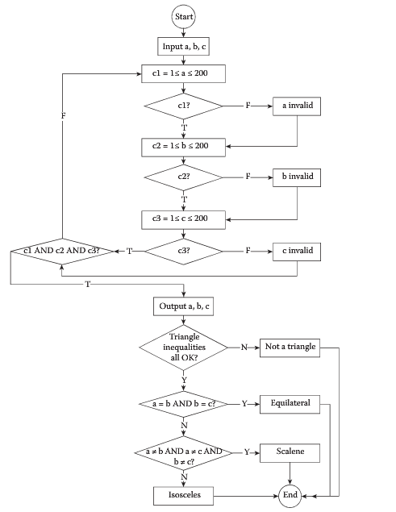
Exercise: Triangle Program
Triangle program: Flow diagram
Only one way to implement this?

Slide 84
Exercise: Triangle Program
Triangle program
Write your exploratory test suite
How you write black-box tests?
How you write white-box tests?
How you write TDD tests?
Later

